Slide 1
Engineering Hands-on
Session 2

Slide 2
CAS
You can use this as a CAS activity!

Slide 3
Reviewing Components
Resistors
Capacitors
Inductors
LED (DO NOT BURN THEM!)

Slide 4
High pass and Low pass filter
BASIC PRINCIPLE:
Capacitors allows AC, blocks DC.
Inductors allow DC, blocks high frequency AC

Slide 5
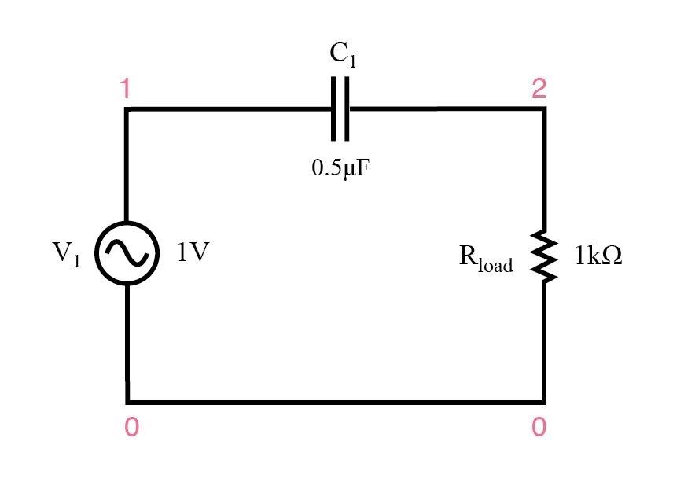
Single Capacitor High Pass Filter
Higher the capacitance, higher the filtering.

Slide 6
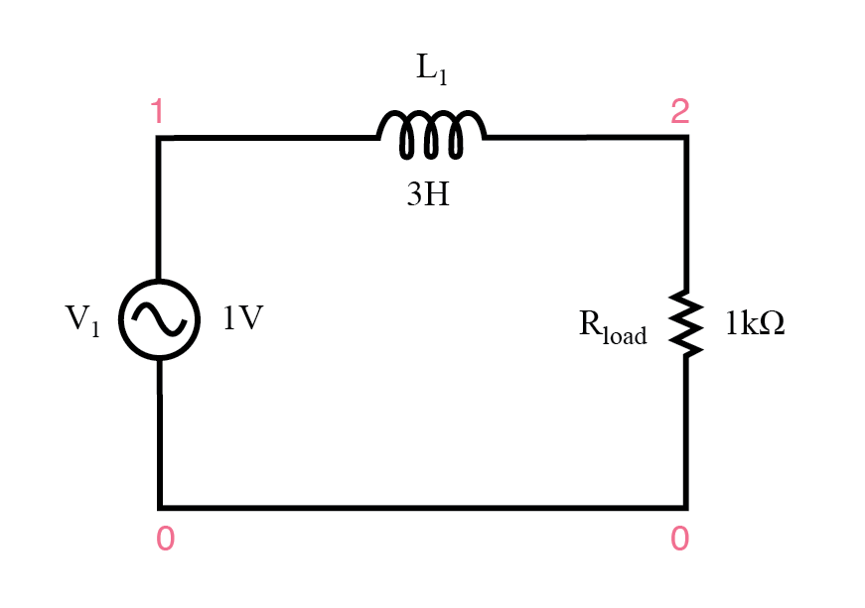
Single Inductor Low Pass Filter
Higher the inductance, higher the filtering

Slide 7
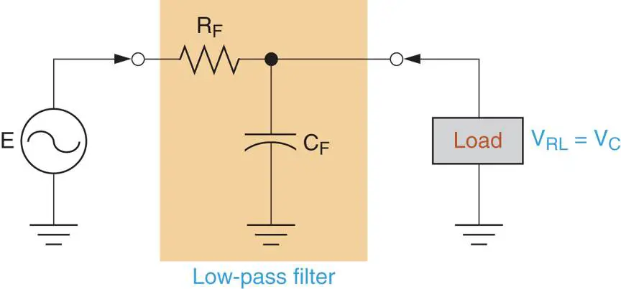
Single Capacitor Low Pass Filter

Slide 8
LC Oscillator

Slide 9
Transistors

Slide 10
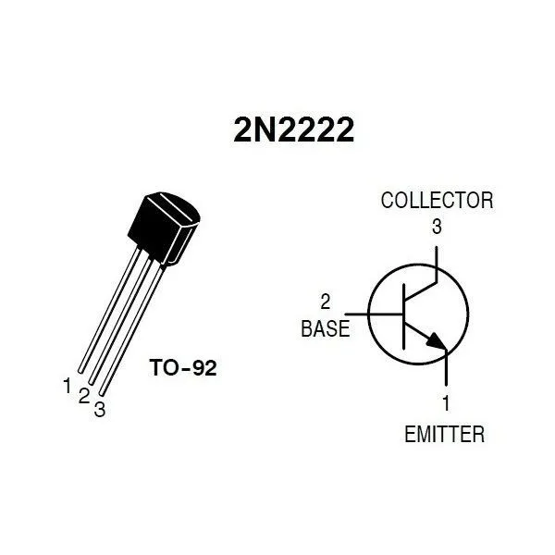
BJT Transistors - electrical switches and amplifier
Source – input
Base – switch
Drain – output

Slide 11
Astable Multivibrator

Slide 12
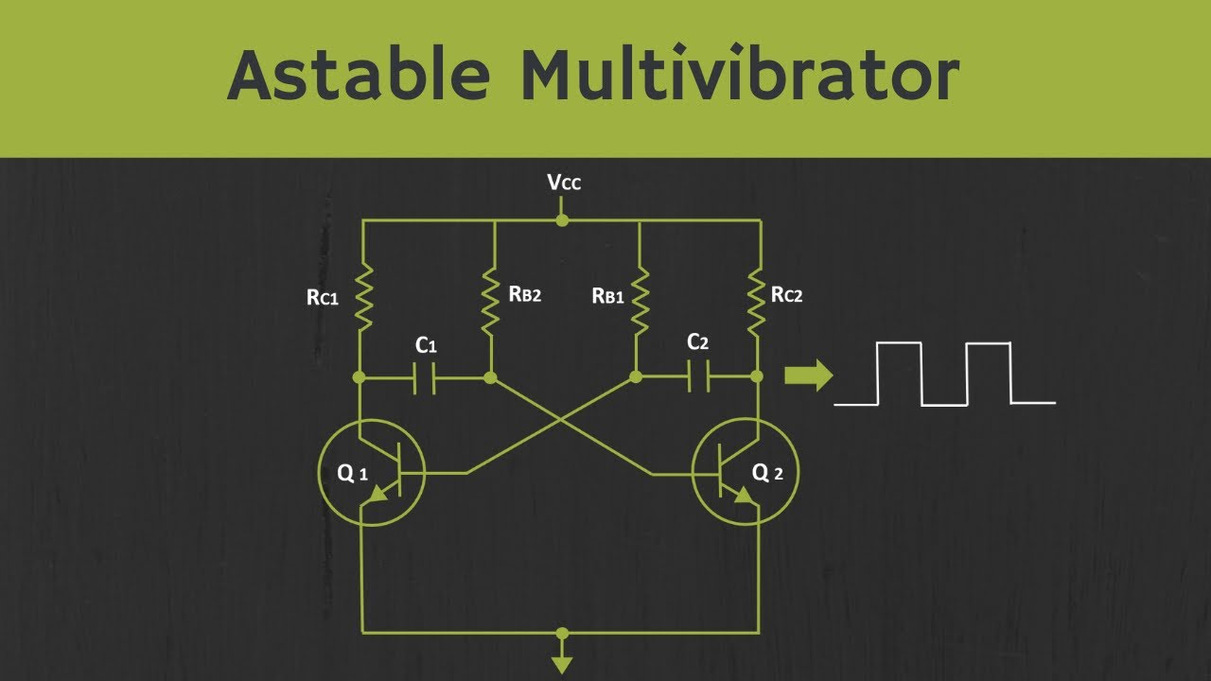

Slide 13
Oscilloscope Time!

Slide 14
BUILDING TIME

Slide 15
The 555 Timer
Astable Mode

Slide 16
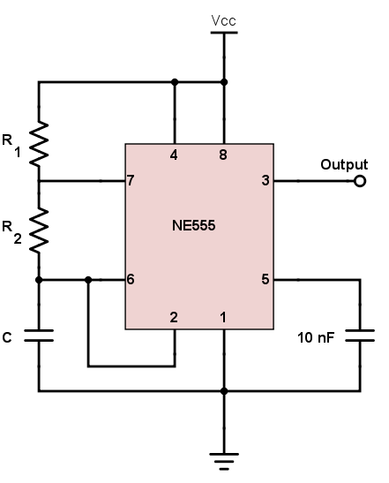
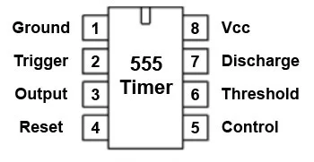

Slide 17
BUILDING TIME

Slide 18
Oscilloscope Time!

